Slide 1


Adarsh Institute of Technology &
Research Centre, Vita
Department of Computer Science & Engineering
Class-TY
Mini Project Presentation
on:
“FARM - TECH”
Team members
1. Miss. Deshmukh Radhika Ravindra (CS3043)
2. Miss. Jadhav Kiran Popat (CS3044)
3. Miss. Patil Samruddhi Pramod (CS3045)
4. Miss. Rajmane Shruti Shankar(CS3046)
Academic Year
2023-2024
Under Guidance of:
Ms. S. L. Jadhav

Slide 2
CONTENT
Introduction
Literature Review
Existing System
Proposed System
Requirement Analysis
System Design
User Interface
Future Scope
Conclusion
References

Slide 3
INTRODUCTION
In this website ,we are give in detail information about Agriculture and its operation.
This system is user friendly.
Data can be stored for longer period with easy accessing.

Slide 4
Literature Review
SR.NO | Title of the Paper | Authors | publisher | Paper Gist
1 | Online Farming System | NingingGe, Hui Li, LingwangGao , IP Mist Lab ,College of Agriculture and Biotechnology China Agricultural University , Beijing, P. R. China | IEEE(2010) | The Present era is the modern age information technology has A huge contribution in this modern age. Most people in the world now rely on information online. And Bangladesh is the main country now depend on Agriculture .In the past people on our country used to grow crops based on information available from TV and radio.
2 | Online Farming System | Abhishek A. G. Department of Information Technology, Ishvari Engineering College, Chennai, India agabhishek@gmail.com | IEEE(2013) | The smart farming system should be used so that the farmers can easily get all the information from the farm . farmers will be able to access all agriculture-related information from the smart farming system, not just from any past of the we talked to ordinary farmers and agricultural entrepreneurs ,about the art farming system and they welcome the initiative .

Slide 5
SR.NO | Title of the Paper | Author | Publisher | Paper Gist
3 | Online Farming System | K. SathishKannan, G. Thilagavathi | IEEE(2016) | Farming System does not provide proper guidance to farmers how to sell their product through online. The current system does not provide classes to formers to get knowledge about how to operate computer. The current system does not providing courses to learn basics of how to register into sites, sell crops and transaction , The Current System does not provide website to farmers in their local languages.

Slide 6
EXISTING SYSTEM
Platform for buying/selling agriculture products.
Links to Social media profiles . sharing option for website content.
Personalized space for registered users . Quick access to relevant tools or information .
Incorporates a feedback system for users to share their thoughts on the platforms effectiveness, allowing for continuous improvement based on user experiences.

Slide 7
PROPOSED SYSTEM
The system help in minimize manual work done by the farmers to get help for farming in a single click .
It help in keeping the farmers updated about the technology of the farming.
Now a day , it has become easy to get information through websites .
There is no need to read newspaper magazines and interview etc are required to get information about farming because each and every information is easily available on the website.

Slide 8
REQUIREMENT ANALYSIS
SR.NO | Name of Resources/ Material | Specification | Quantity | Remark
1 | Hardware | RAM 4GB Intel core 13 or above, Hard disc 16 GB, Windows 8 above | 1 | To type the data
2 | Internet | 2 mbps | 1 | To collect the information
3 | Software | HTML,CSS, Google Chrome ,Firefox | 1 | To compile and run the program
4 | Database | XAMPP | 1 | To store the data

Slide 9
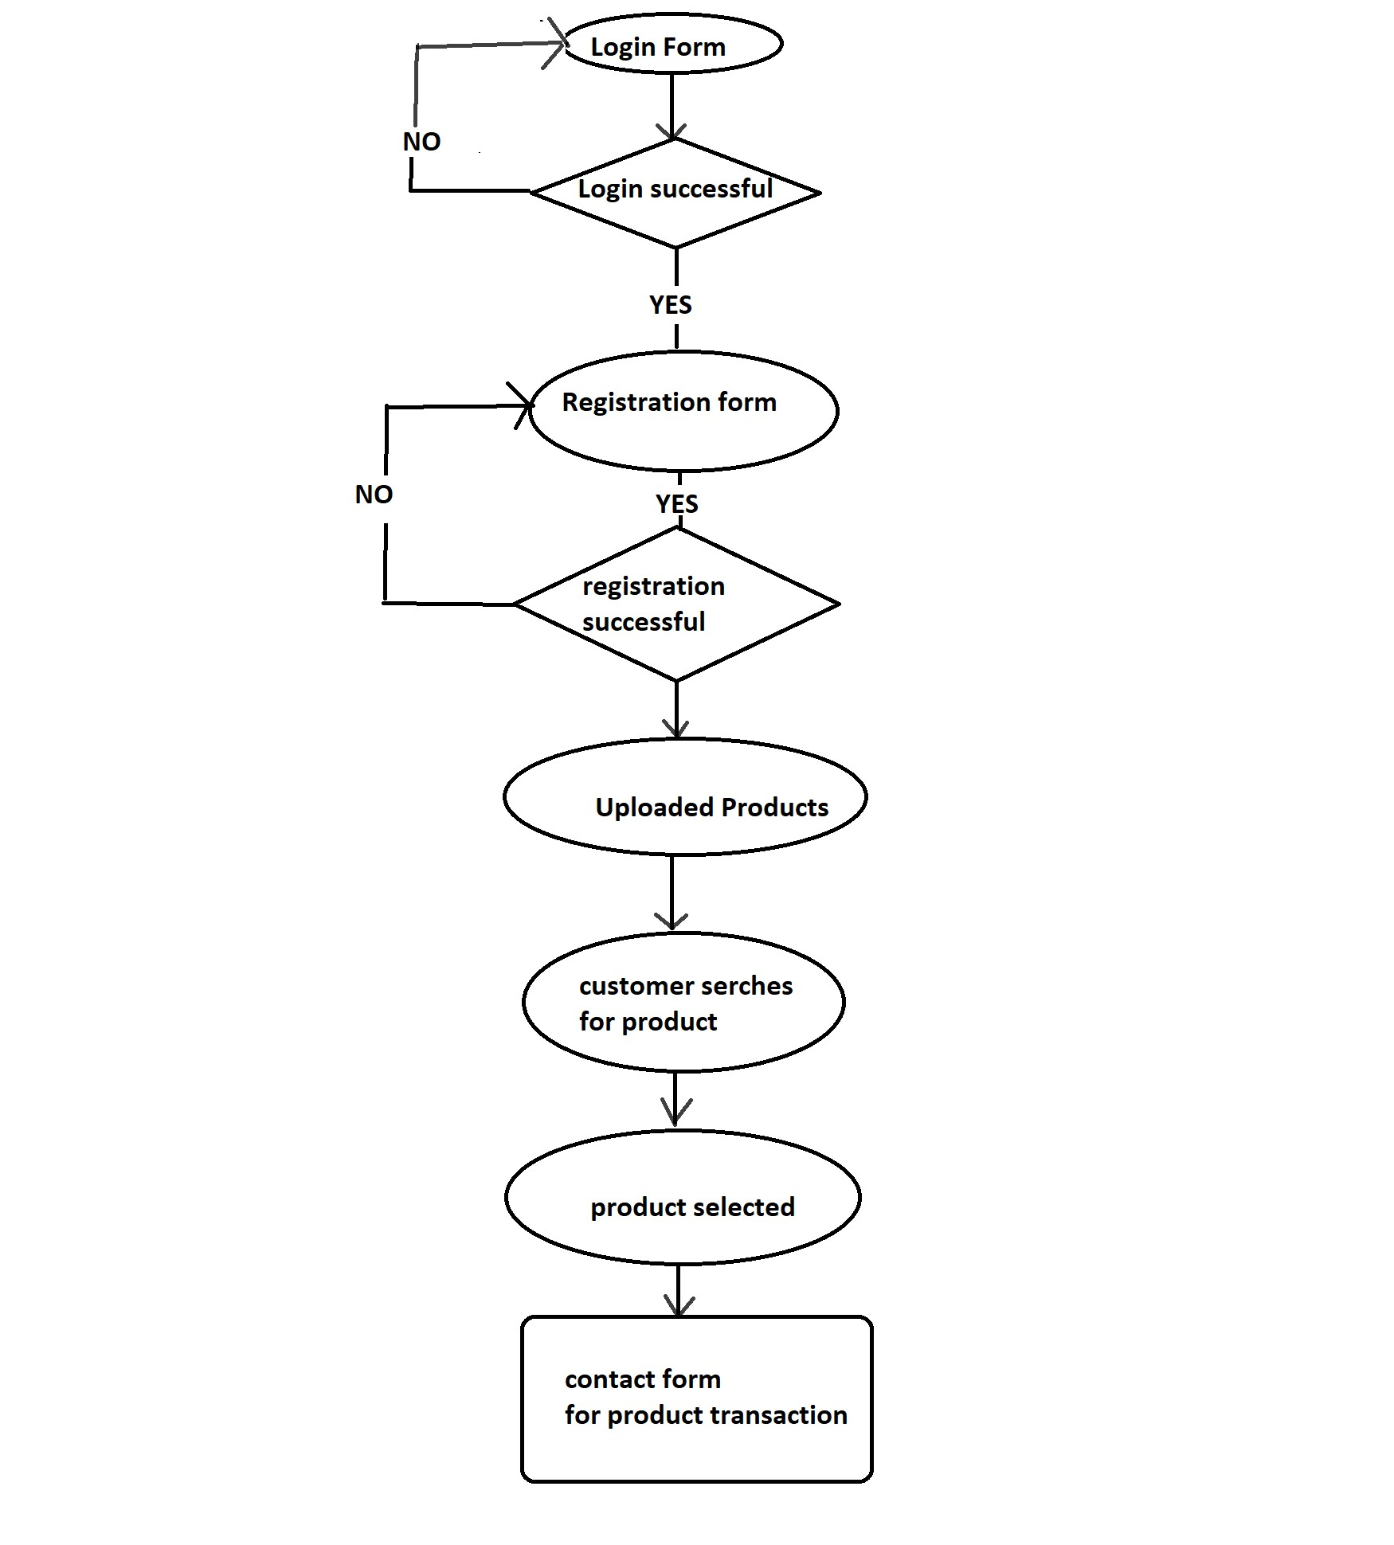
SYSTEM DESIGN

Slide 10
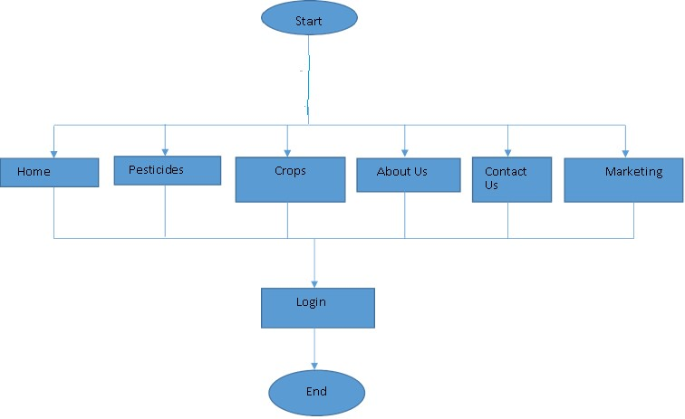
FLOWCHART

Slide 11
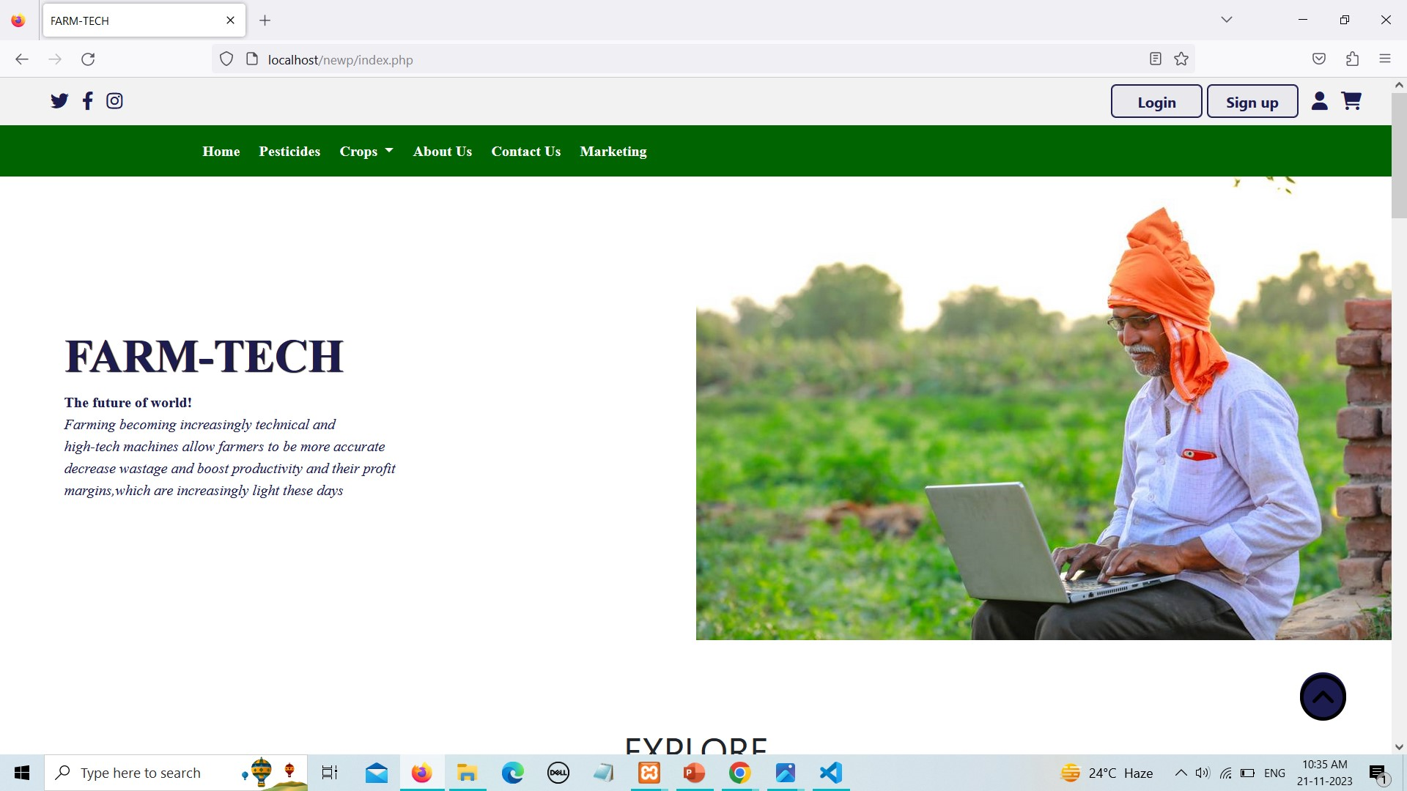
USER INTERFACE
Screenshot : Index Page

Slide 12
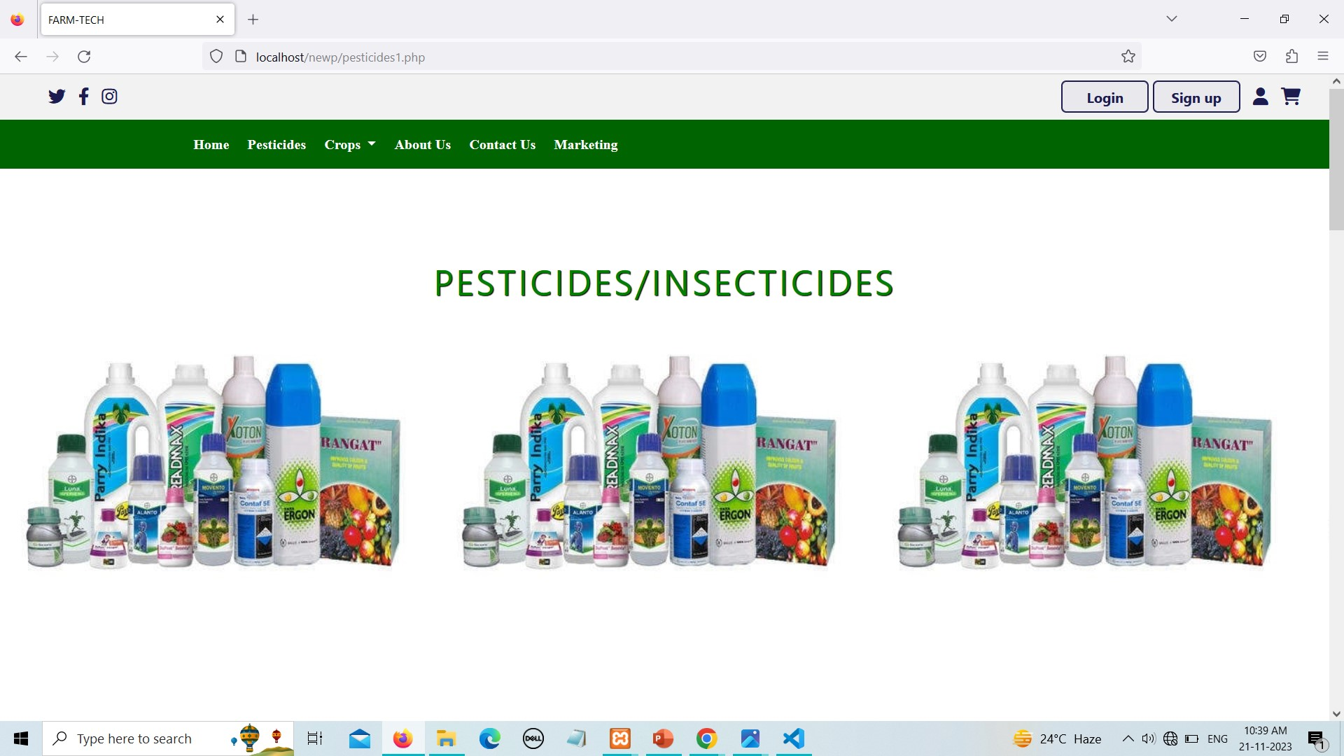
Screenshot : pesticides

Slide 13
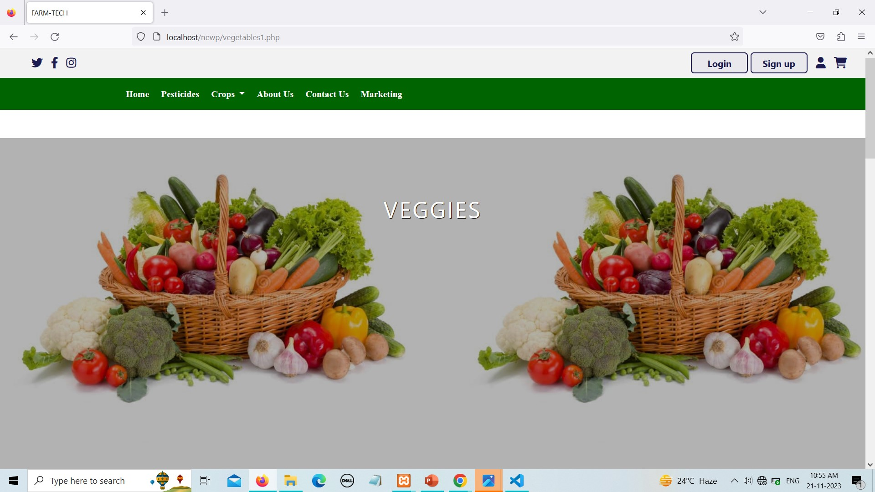
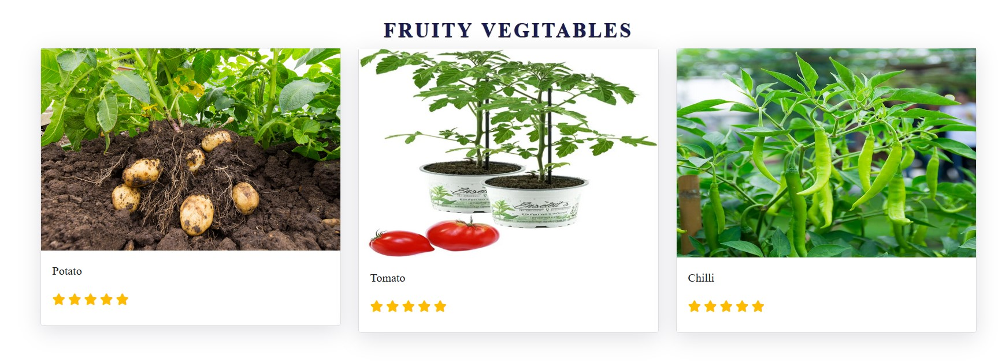
Screenshot: Veggies

Slide 14
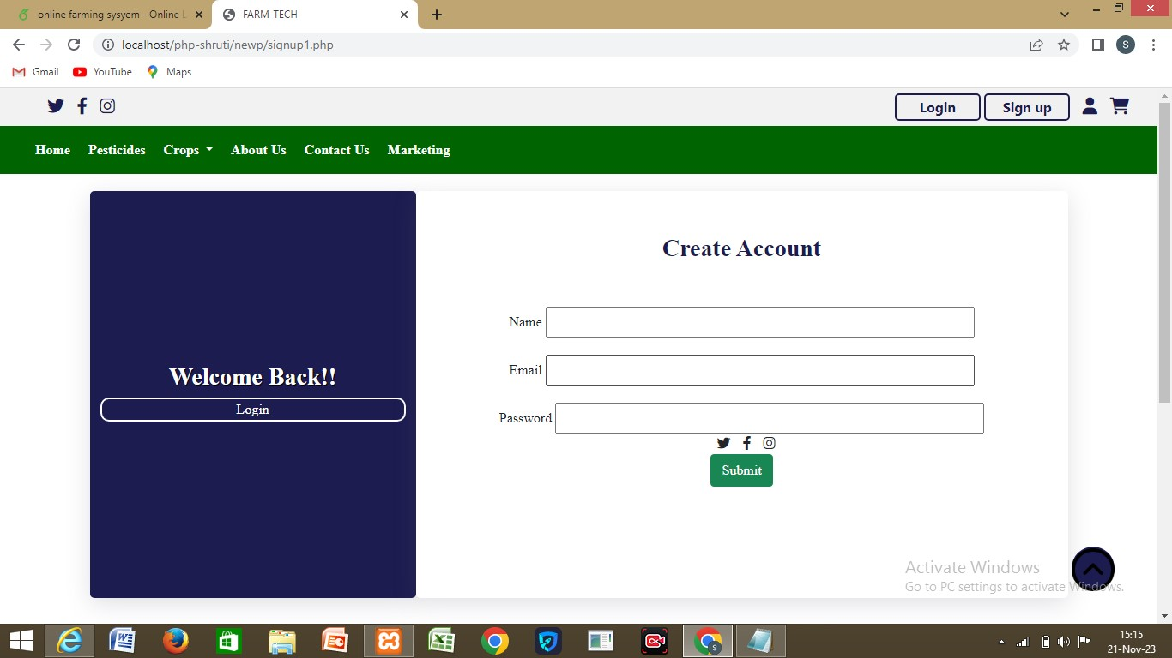
Screenshot : Sign Up

Slide 15
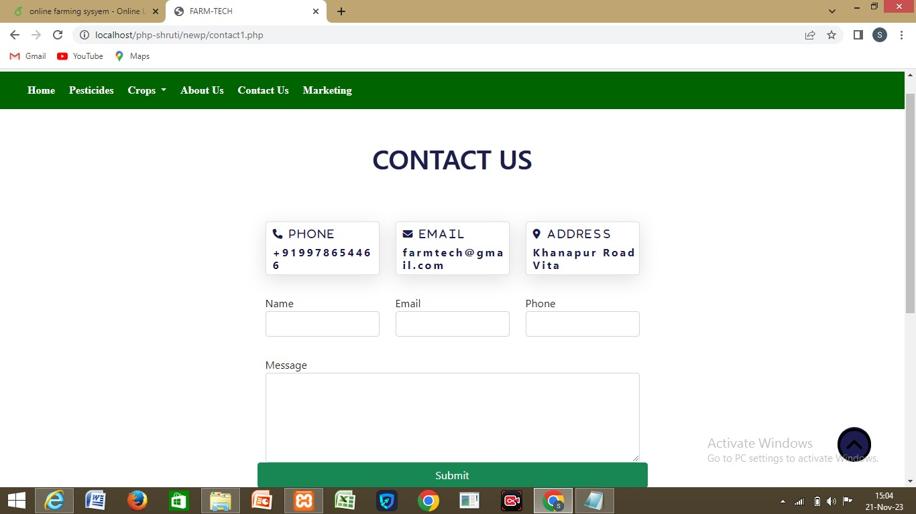
Screenshot : Contact Us

Slide 16
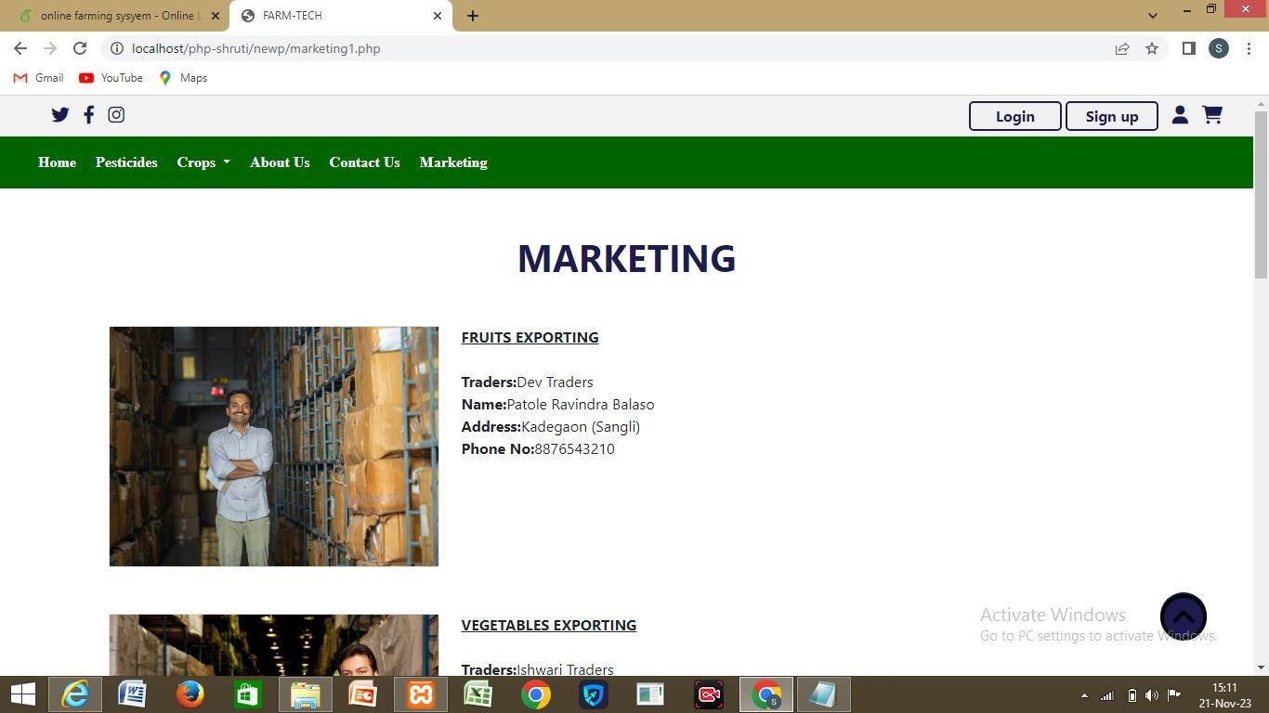
Screenshot : Marketing

Slide 17
FUTURE SCOPE
Mark place and Supply chain Management .
Financial and Resources Management .
Mobile Application for Farmer.
Environmental monitoring .
Global Collaboration.

Slide 18
CONCLUSION
Easy access to information ,resources and services related to Agriculture for Farmers .
Website enable farmer to showcase and sell their products directly to consumers, expanding their market reach and potential profits.

Slide 19
REFERENCES
Example of Journal Paper
1. S. Siva Ram Murthy and B.S .Manoj, “Ad Hoc Wireless Network Architecture And protocols ”, Second Edition ,person publication 2004
2. Abhishek A.G .(2016) “Creating Agriculture marketing using Web and Mobile Based Technologies Web Pages, 1st Edition.
Example of book reference:
The wizard and the Prophet Charles C . Mann.
Ramro : The story of Indians Farm Crisis Jaideep Hardikar .
Example of Online website:
https://farmer.gov.in
https://agricoop.gov.in

Slide 20

Thank you..!

